Slide 1
Meteorological Computer Model
Northeastern Illinois University CS 490
Eric Oij

Slide 2
Technologies Used:
JAVA SE 8
Eclipse IDE
Sublime Text
QGIS

Slide 3
Project Architecture
FTP Client – Fetch Weather Balloon Data
Model Initializer – Build a weather map
Physics – run equations on data points to move data through time
GIS display – display the data

Slide 4
FTP Data Fetcher
Connects to National Climatological Data Centerhttps://www.ncdc.noaa.gov/data-access/weather-balloon/integrated-global-radiosonde-archive
Finds files that contain US in the title (96 balloons that are launched every 12 hours across the United States
Downloads these files which contain every balloon launch since 2016, each file is about 2.5-5 MB of text, and for the purpose of this project, we care about the final entry of this file, only signifigant levels, or lines that start with the number one.
Utilized a wonderful piece of code that searches these files backwards
Writes these lines to a temporary file
Re-utilized the backwards reader to append these lines to a file that will eventually become the input for the initialization component
Write this to a text file and continue on to the next balloon until all of the weather balloon data has been written to a text file.
Delete files that have been downloaded.

Slide 5
FTP Data Fetcher
Issues that I had to overcome:
Searching the files from the bottom, as the first process was taking an untenable amount of time searching from top down
Login issues that were not very well documented on how to fix
The fact that the file is not rewritten every time the product is run. (we’ll talk about this later!)

Slide 6
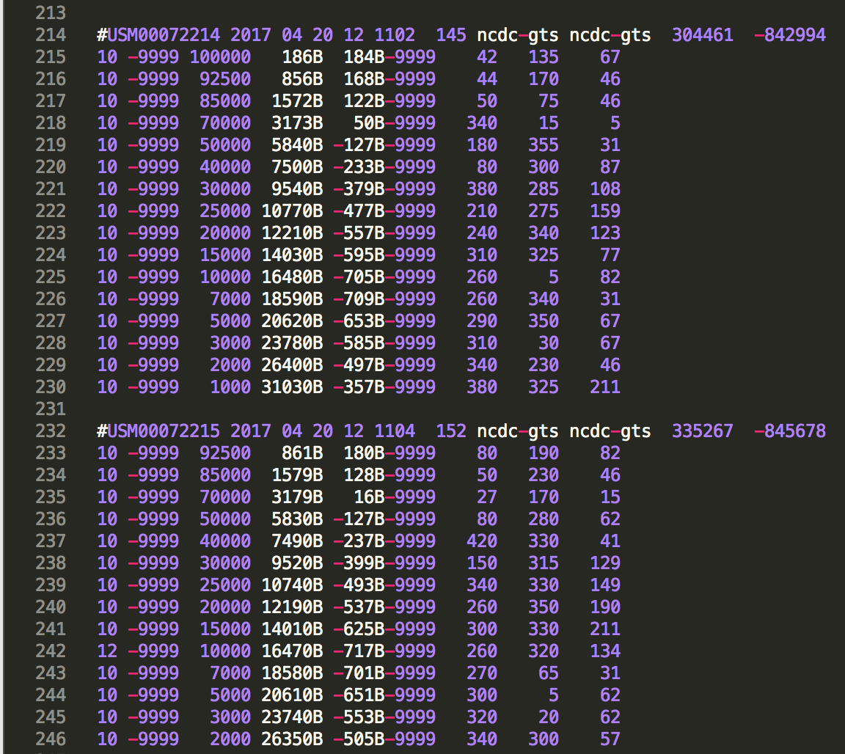
FTP Data Fetcher
Sample output of this data:
Station ID
Date
Time
Latitude
Longitude
Pressure
Geo-Height
Temperature
DewPoint Depression
Relative Humidity
Wind Direction
Wind Speed

Slide 7
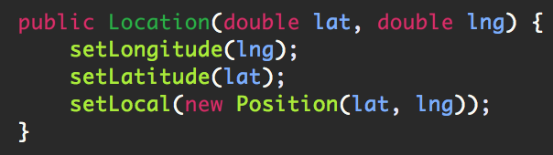
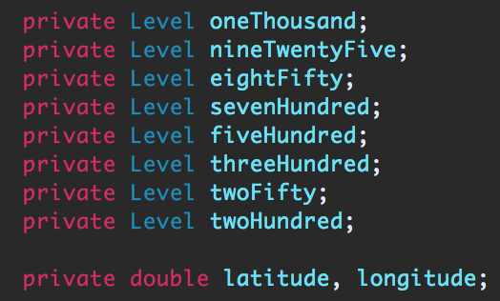
Map Initialization
Stores these values into objects that then are stored in an Array List of Locations
Locations are where the data is stored, starting with Latitude and Longitude. Constructor:
Locations are also made up multiple levels, which are set individually. Levels are where the physical data is stored.
Values associated with each location:

Slide 8
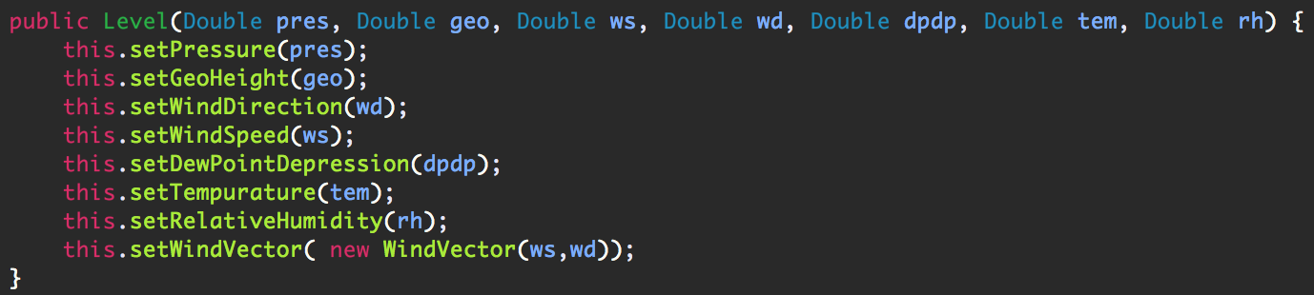
Map Initialization
Each level is built of the physical attribute that are ascertained from the weighted averages of the nearest balloons.
A wind vector is also calculated with this as well, which gives u and v (wind in the latitude and longitude directions accordingly)
Levels are identified with pressure, and thus this value remains constant for all
Many times these values do not exist at the nearest balloons, and thus are set to 9999. If this is the case, then the value is ignored and set to only the nearest balloon number

Slide 9
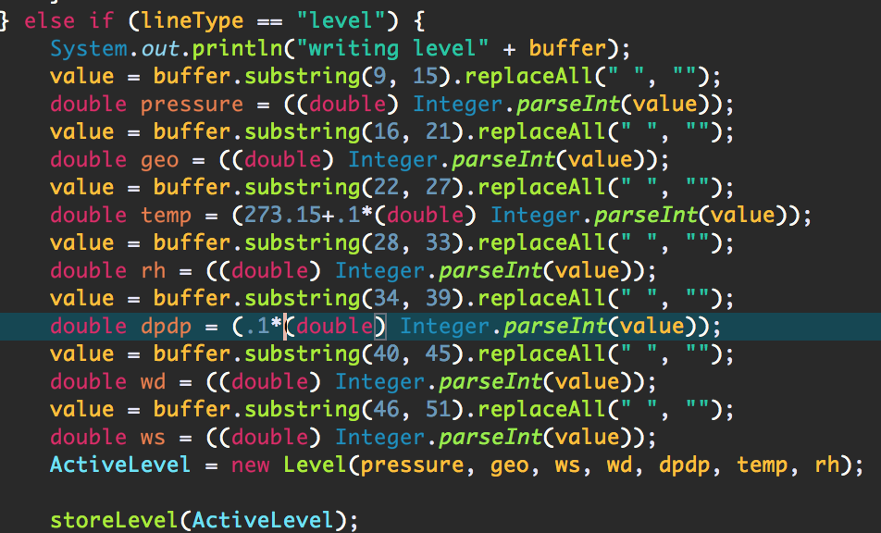
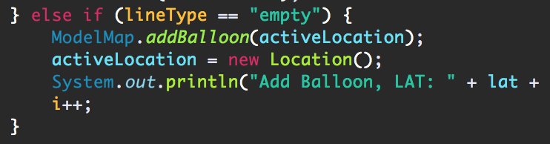
Map Initialization
Data is read in from each balloon and is an ArrayList<Location> is built to house the data from the 96 weather balloons.
Built the same as the map for the model, except instead of being on a grid, these are stored according to the latitude and longitude of the balloon as read in by the program.
Each line of the balloon data file is parsed, when a line starts with ‘#’ a new station is created, or location object is instantiated.
The following lines are then read in, and parsed by char number to the corresponding physical attribute.
Once all levels are stored, the location is stored.

Slide 10
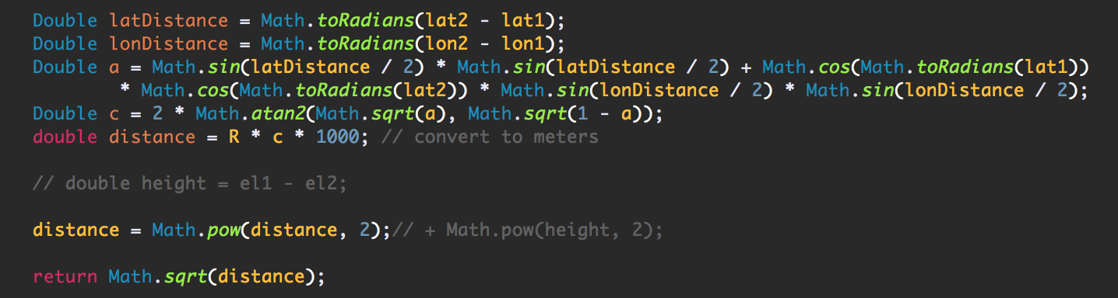
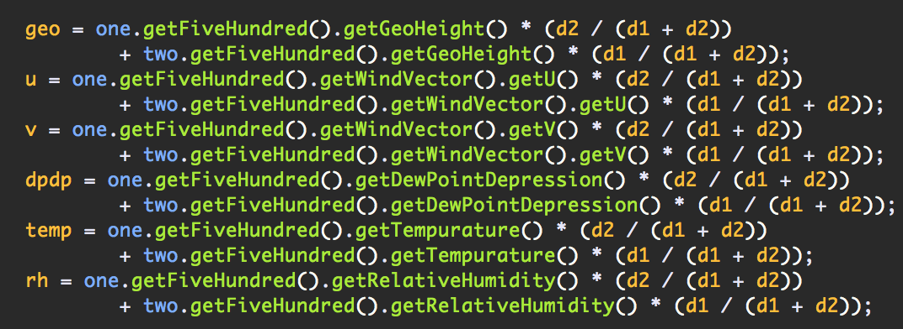
Map Initialization
Takes input from weather balloon data and runs a weighted average from the two nearest balloons for the map coordinates on the inside of the map, or when the coordinates do not equal the min or max latitude or longitude
Finds the nearest balloon location for the outside of map
Wanted to use kiddy corner balloons to do this (balloons that are in opposite quadrants of a Cartesian coordinate system), but found this to be overtly challenging, thus took just the two nearest
Uses Haversine distance formula to find distances across a sphere
Weighted Averages code:

Slide 11
Map Initialization
Difficulties
It took me way to long to realize that Java’s Math.sin() required radians and not degrees, my initialized map would have strange periodic errors that were difficult to debug
My FTP balloon map appends to the balloon data file and does not overwrite. This took me months to find as I had written off my FTP balloon mapper as a completed self contained portion of the project. My initialization was such taking data from multiple data points and giving me strange erroneous data. I finally found this when I completely re-wrote many portions of my code in a separate project and was getting the same data/output between the two projects, only to find that my balloon data file was 100 times as long as it should have been.

Slide 12
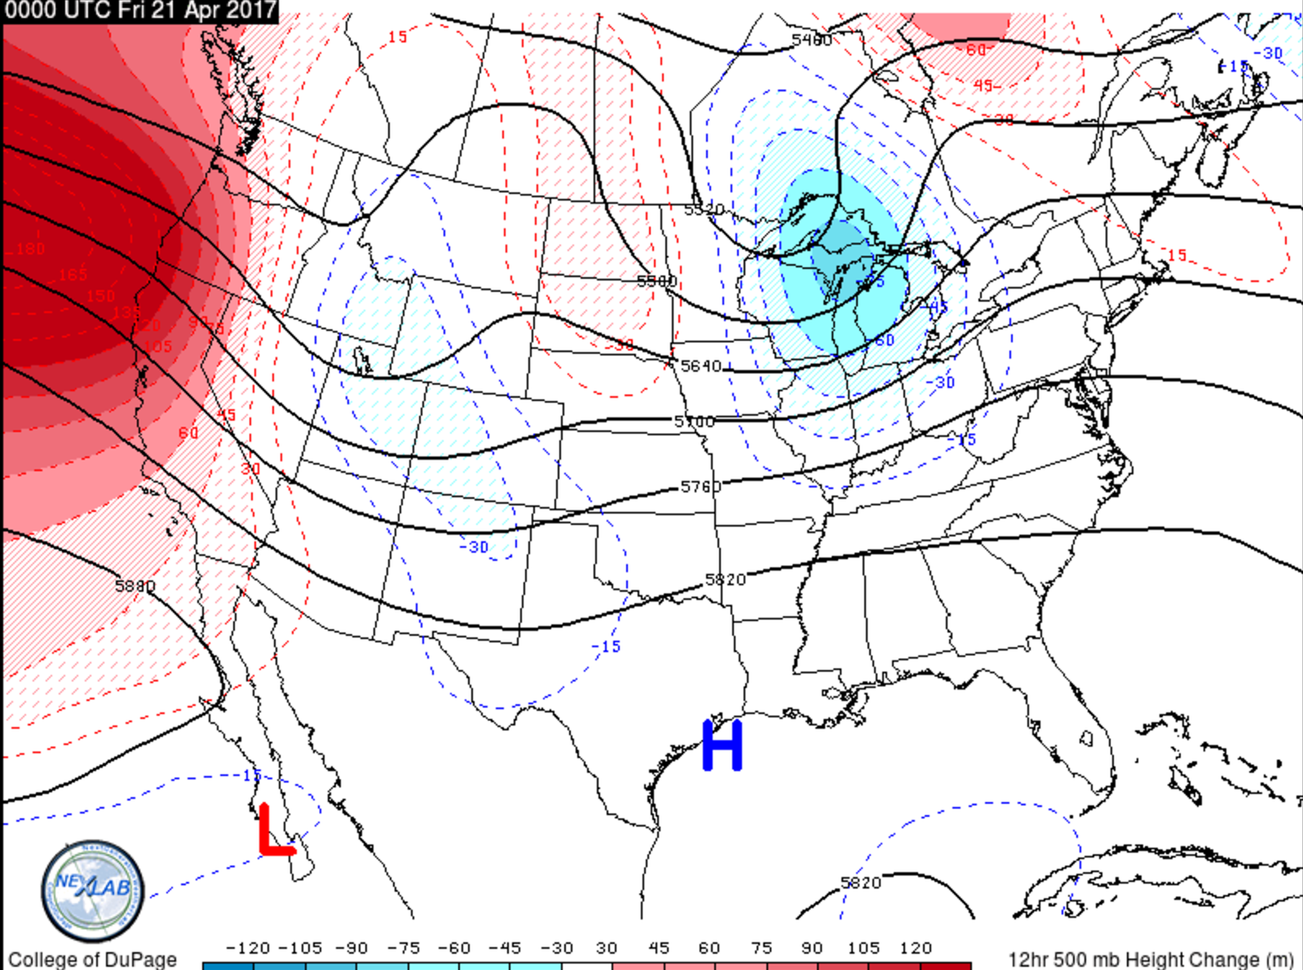
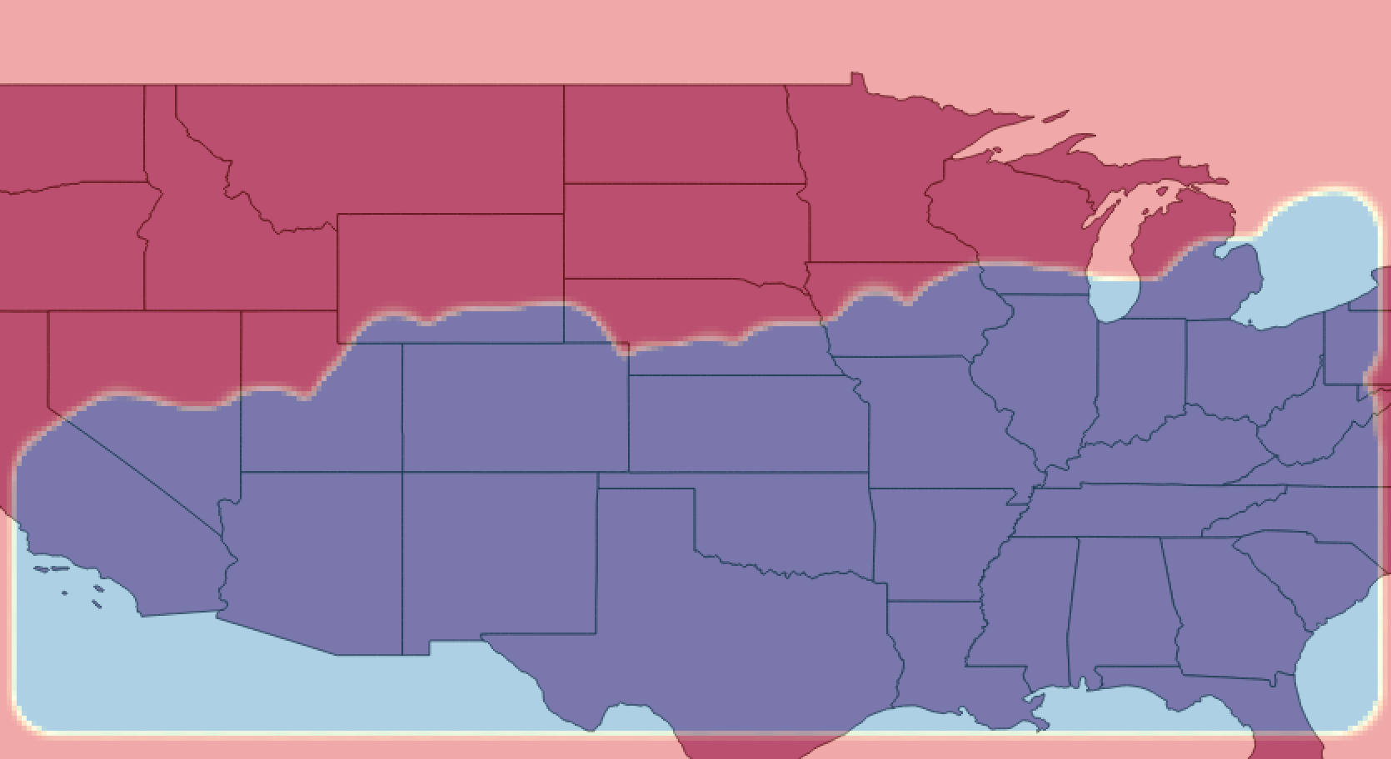
Map Initialization
Proof of concept:
I set a threshold of 5700 m to the following GIS output, which you can compare to the NWS output map and see the similarities of pattern

Slide 13
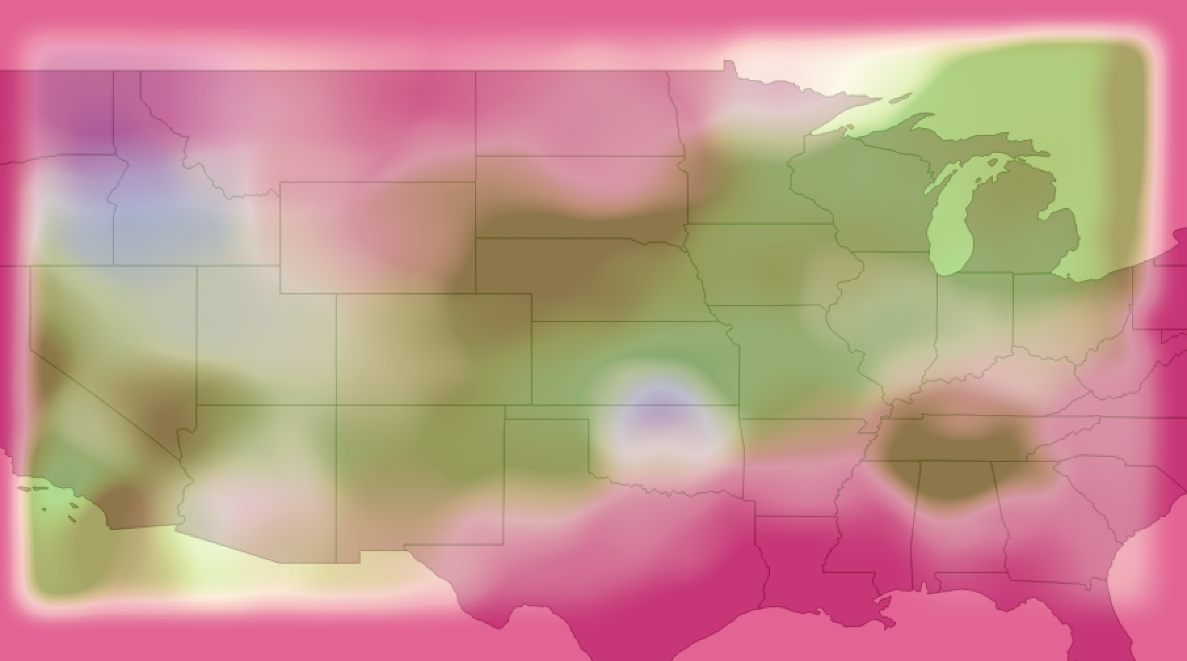
Map Initialization
Proof of Concept Cont. 500mb U (green) and V (Blue), clearly see Jet Stream

Slide 14
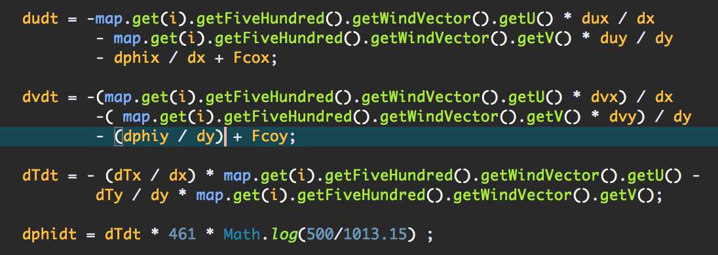
Physics Module
Using the so called Primitive Equations, built a way to calculate derivatives of physical values.
Using attributes from weather balloons, can calculate changes in temperature, wind vectors, and geo-potential height.

Slide 15
Physics
Once again used Haversine’s distance formula to calculate distances. As the area in question is not a true rectangle, need to treat distances as such, because higher latitudes mean shorter distances between longitudes
Used the fact that the initialized map is set on a grid to calculate changes.
Simplified from multiple levels to a single level, 500 mb, as this level is most likely to contain complete data, and this module also takes a long time to run with only one level, let alone the 8 originally planed
Can be scaled pretty easily to include more levels
Written to be scaled size wise as well.

Slide 16
Physics Module: Analysis of Data
Upon analyzing data from multiple runs of data, there are large data discrepancies that cannot be accounted for
Most data makes sense, however there are outliers that are many orders of magnitude off the rest of the data
Something is also happening to the edges of my map, not consistently though…
Data is not coherent enough to display on a GIS map of any kind.

Slide 17
Future of the Model
Would have liked to spend more time with GIS software and an expert on this software in order to produce more meaningful plots, have identified people at work that will be able to help me
Refactor and further debug physics module to produce less erroneous data
Build a javascript-arcgis page that runs the model hosted on a raspberry pi or cloud based platform that automatically runs and uploads the model data to the site
Update data stores to SQL or Mongo database instead of text files
Presenting this project in the Dev-Ops lab at NASA-JPL in June

Slide 18
References
http://www.qgis.org/en/site/
https://www.ncdc.noaa.gov/
http://weather.cod.edu/
Atmospheric Science, an Introductory Survey, J.M. Wallace, P.V. Hobbs, 1977, Academic Press
http://crunchify.com/how-to-read-a-file-line-by-line-in-reverse-order/
gis.stackexchange.com
http://www.spc.noaa.gov/
http://www.codejava.net/java-se/networking/ftp/java-ftp-file-upload-tutorial-and-example

